Slide 1


Slide 2
Modularity

Slide 3
Design
Software design is a process to transform user requirements into some suitable form, which helps the programmer in software implementation.

Slide 4
Modularity
Software is divided into separately divided components often called as modules.
Divide and Conquer Approach.

Slide 5
Modularity
A complex system may be divided into simpler pieces called modules.
A system that is composed of modules is called modular.
Supports application of separation of concerns
When dealing with a module we can ignore details of other modules

Slide 6
Module (Cohesion and Coupling)
Each module should be highly cohesive
Module should be understandable as a meaningful unit
Components of a module are closely related to one another
Modules should exhibit low coupling
Modules have low interactions with others
Understandable separately
Notes:
cohesive=united and working together effectively
low coupling= coupling is the degree of interdependence between software modules

Slide 7
A Visual Representation
high coupling
low coupling

Slide 8
Advantages of Modularization
• Smaller components are easier to maintain.
•Program can be divided based on functional aspects.
• Desired level of abstraction can be brought in the program.
• Components with high usage can be re-used.
• Concurrent execution can be made possible.

Slide 9
Five Criteria
A design method worthy of being called “modular” should satisfy five fundamental requirements:
Modular Decomposability.
Modular Composability.
Modular Understandability.
Modular Continuity.
Modular Protection.

Slide 10
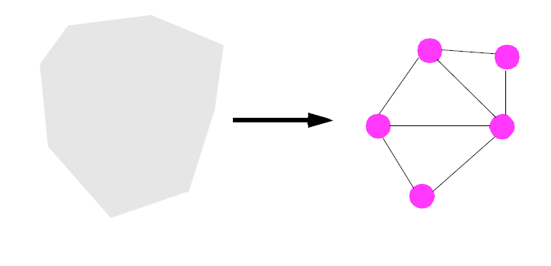
1.Modular Decomposability
A software construction method satisfies Modular Decomposability if it helps in the task of decomposing a software problem into a small number of less complex sub problems, connected by a simple structure, and independent enough to allow further work to proceed separately on each of them.

Slide 11
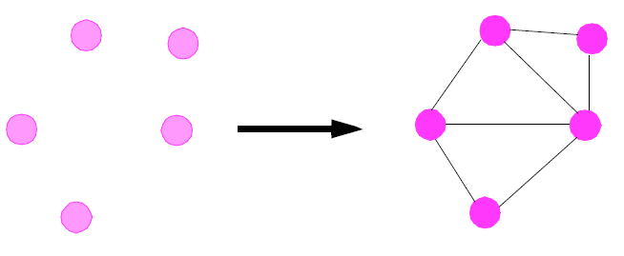
2.Modular Composability
A method satisfies Modular Composability if it favors the production of software elements which may then be freely combined with each other to produce new systems, possibly in an environment quite different from the one in which they were initially developed.

Slide 12
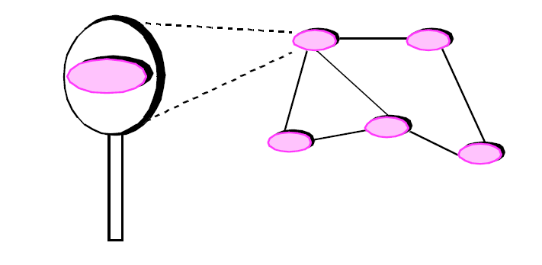
3.Modular Understandability
A method favors Modular Understandability if it helps produce software in which a human reader can understand each module without having to know the other modules, or at worst by having to examine only a few of the other modules.

Slide 13
4.Modular Continuity
A method satisfies Modular Continuity if, in the software architectures that it yields, a small change in a problem specification will trigger a change of just one module, or a small number of modules.
Notes:
A method satisfies modular continuity if

Slide 14
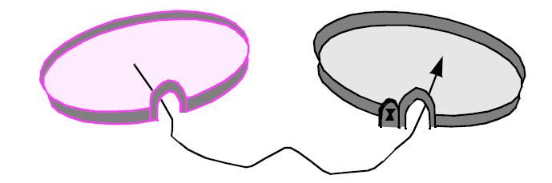
5.Modular Protection
A method satisfies Modular Protection if it yields architectures in which the effect of an abnormal condition occurring at run time in a module will remain confined to that module, or at worst will only propagate to a few neighboring modules.

Slide 15
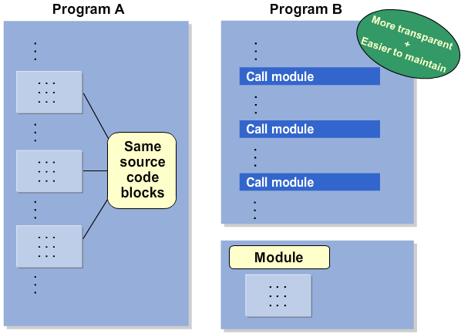

Slide 16
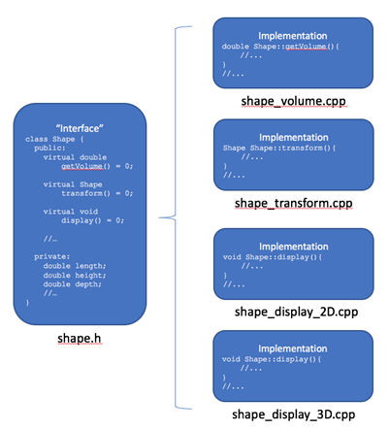
Coding Example

